Slide 1

Github Topic Suggester
Team
Dmitry Pogrebnoy
Maria Tigina
Maxim Zuev
Ksenia Razheva

Slide 2
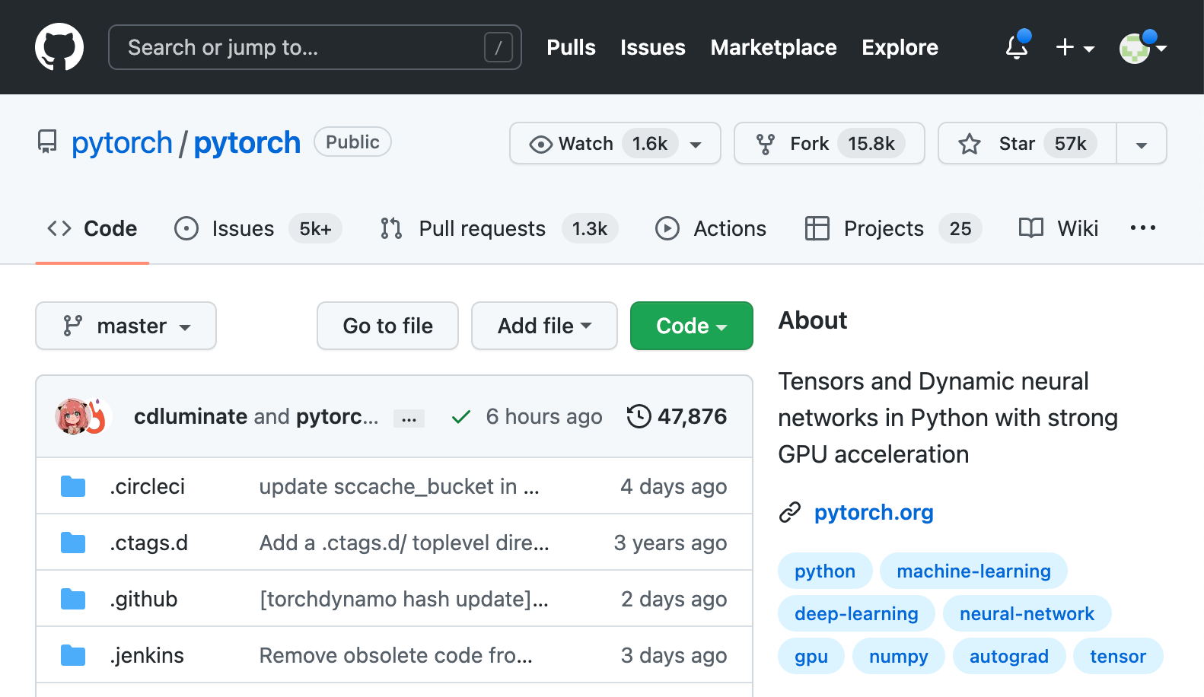
Introduction
GitHub - world's largest host of source code
GitHub have 200+M repositories and 83+M developers
Repositories are not labelled or are labelled inadequately
This makes it difficult for users to find relevant projects
topics
2/15

Slide 3
Github topic suggestion
Papers about the suggestion project topics for Github:
Topic Suggestions for Millions of Repositories by Github team
Repo names
Descriptions
READMEs
GitRanking: A Ranking of GitHub Topics for Software Classification using Active Sampling by Cezar Sas et al.
Descriptions
READMEs
3/15

Slide 4
Main goal
Develop a tool for predicting topics for a project by code using imports of libraries or packages that are used in it.
Plan:
Download popular repositories with topics from GitHub
Extract imports from source code of repositories
Train the model to predict topics from list of imports
Develop app for topic prediction for new repositories
4/15

Slide 5
Data collection
List of repositories: Github Topics and Repositories 2022
Filter only Python/Kotlin related projects
Data volume
5 parts
2800 repos
430GB
GitHub API for repos loading and label requests
5/15

Slide 6
Data processing
Lupa tool for extracting import information in projects
Build docker container for run Lupa tool
Combine imports dataset and topics dataset into one
Filter most common topics
Group imports to packages
Build final dataset for further steps
6/15

Slide 7
Explanatory data analysis
Number of projects - 2836
Imports:
Average imports per project - 188
Median imports per project - 43
Packages:
Average packages per project - 28
Median packages per project - 18
7/15

Slide 8
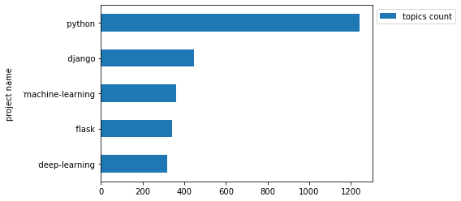
Top 5 topics
8/15

Slide 9
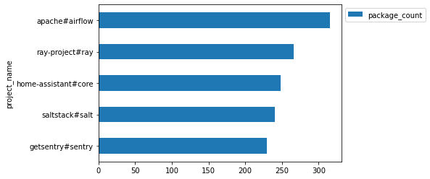
Top 5 projects by package number
9/15

Slide 10
Topic suggester model training
X =
 | package#sklearn | package#torch | …
user#project | TF-IDF | …
2900 projects
4000 packages
XGBoost(X) = y
 | topic#android | topic#ml | …
user#project | 0/1 | …
y =
2900 projects
300 topics
10/15

Slide 11
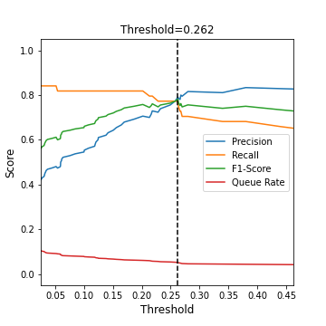
Topic suggester model
Train model
Select threshold (data imbalance)
Save model’s configuration
 | f1-score
Max | 0.88
Min | 0.52
Avg | 0.7
11/15

Slide 12
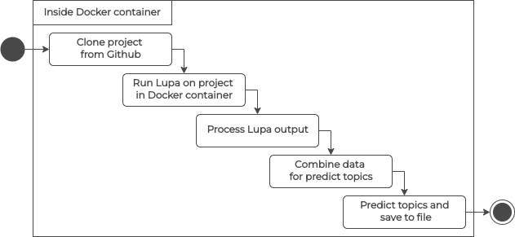
Pipeline
12/15

Slide 13
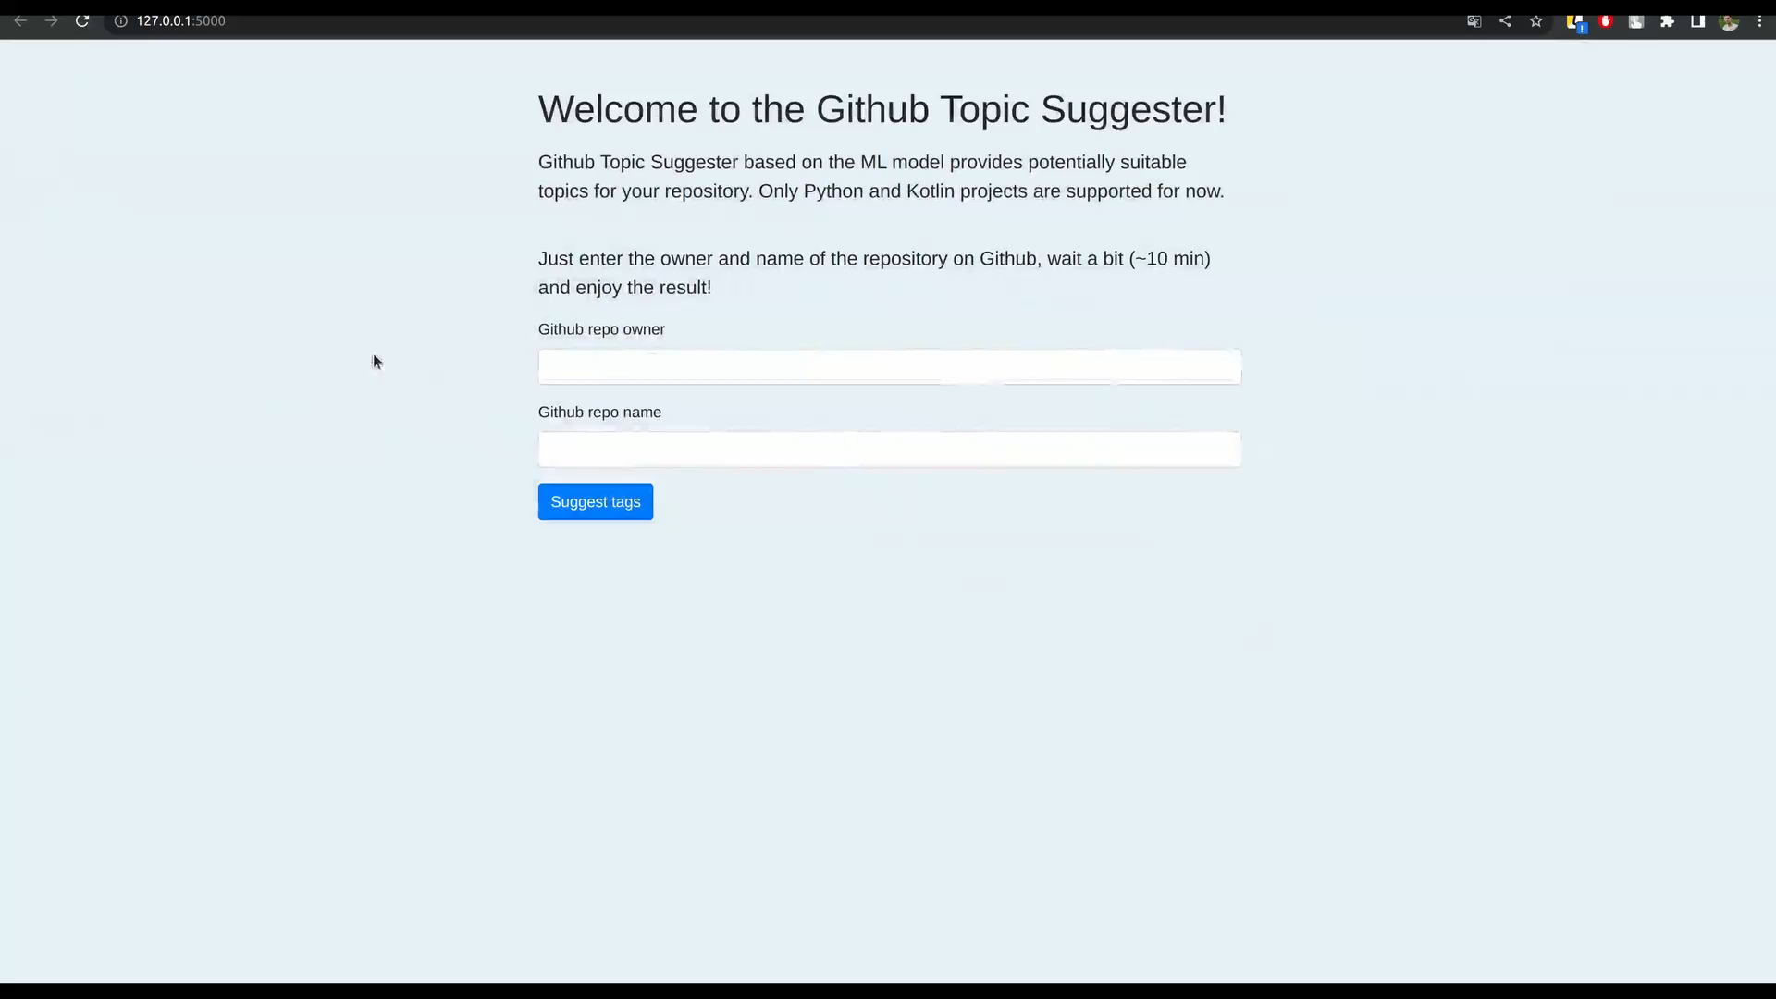
Demo
13/15

Slide 14
Technologies
Docker - run Lupa and Pipeline
Spark - data processing and pipeline processing
XGBoost - builds topic predictor
Flask - builds demo app
Celery - runs pipeline on a separate worker
14/15

Slide 15
Conclusion
Repositories from Github are collected
Repositories are processed and import infos are extracted
Explanatory analysis is conducted
Topic predictor is built
Topic suggestion pipeline is constructed
Demo web-application is created
Sources - github.com/zuevmaxim/itmo-ibd
15/15

Slide 16
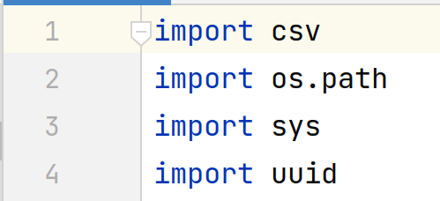
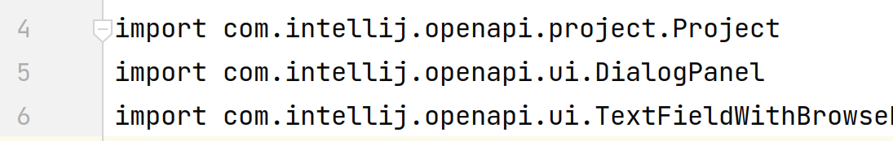
Library imports
Python imports
Kotlin imports
16/15

